Slide 1
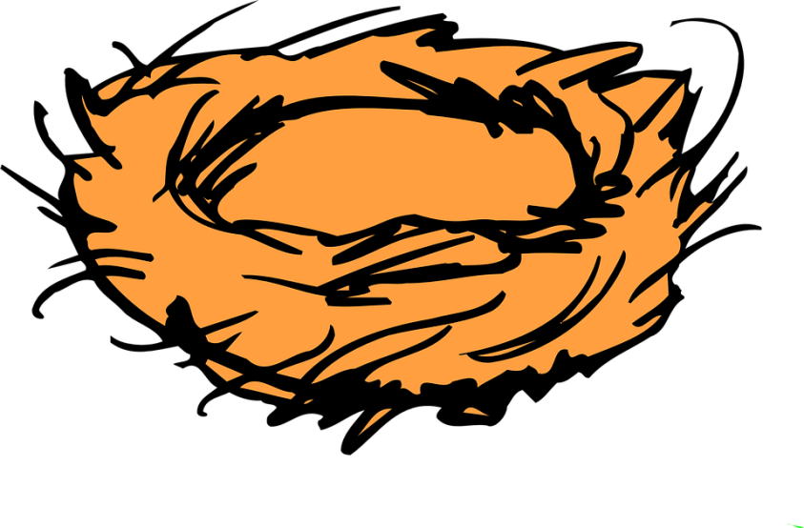
Empty Nest
Full Life
Part 4:
MOSES: The Flawed Friend Of God

Slide 2

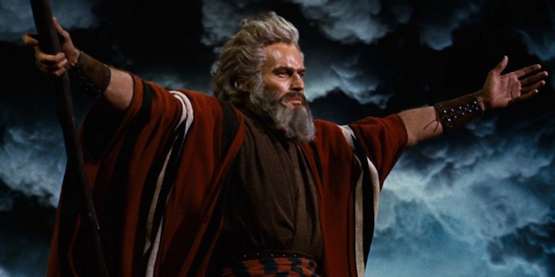
The Story Of Moses

Slide 3
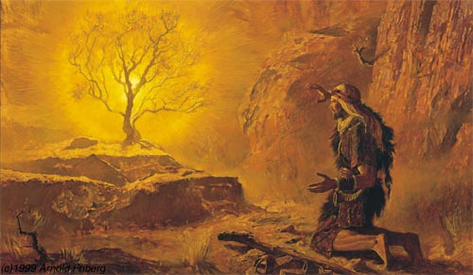
Moses’ Mission...
Moses’ most important mission began in his Second Half of life...

Slide 4
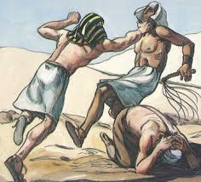
Moses:
Flawed Friend of God
-Temper
-Reluctance
-Complained
-Lack of confidence/shy.
God uses time and pain to mature us.
That's why he often has important work for us in our second half of life.

Slide 5
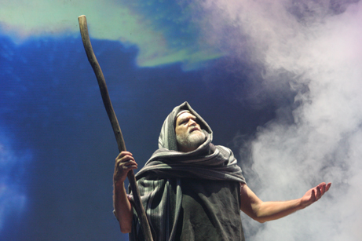
Moses:
God’s Servant and Friend
Moses Remained Teachable.
Moses Stuck With God Through His Stages Of Life.
Moses Was A Disciple Maker.

Slide 6
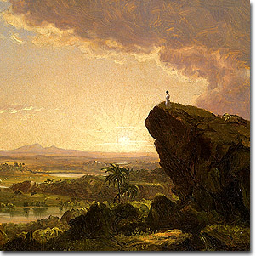
Moses:
Flawed Friend Of God
Your Most Important Season Is Still Before You.

