Slide 1
Empty Nest - Full Life
Part 2:
LONELINESS

Slide 2
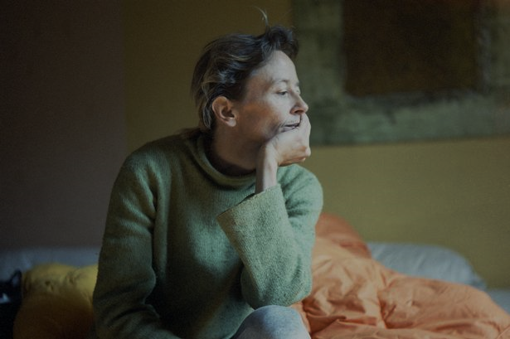
Loneliness
Of all the emotions we face,
of all the suffering we endure,
LONELINESS
is the component that is most universal.
The LORD God said, “It is not good for the man to be alone. I will make a helper suitable for him.” Genesis 2:18

Slide 3
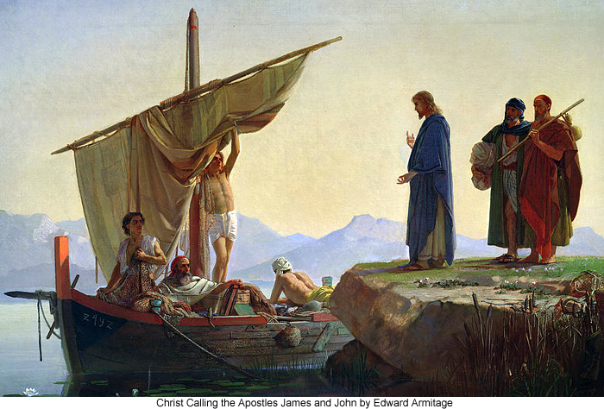
Can you spot the lonely person in this passage? Mark 1:16-20
^{Mk 1:20} …they left their father Zebedee in the boat with the hired men and followed (Jesus).

Slide 4
Reasons for Loneliness
Abandonment (Joshua 1:5)
Rejection (Psalm 27:10)
Conflict and Adversity (Romans 8:38-39)
Grief and Loss (Psalm 65:5-6)
Life Transitions (Joshua 1:9)
Fear of the Future (Isaiah 41:10)

Slide 5
Loneliness: How to Heal How to Deal
Loneliness doesn't have to be a life sentence, and it definitely doesn't have to be a death sentence.
The presence of God helps.
Accepting what can be changed/Knowing what cannot be changed, helps.
Being interested in something helps you to be interesting.

Slide 6
Loneliness: How to Heal How to Deal
Planning today to make a friend tomorrow, helps. What you are sowing into today can help you make a friend tomorrow?
Taking care of your inner and outer self helps. Do you watch other people experience life and use creativity while you experience a bag of chips and use the remote control?
Telling someone you are lonely helps.

Slide 7
Not A Sin, But Watch Out!
Loneliness is not a sin, but sometimes the shortcuts to find relief can be sinful.

Slide 8
You, your neighbour and God.
Your loneliness is a sign that you are created to be social.
Who are the lonely people in your life?
Don’t forget your Heavenly Father.

